Slide 1
SaaS Training Model walkthrough
May 2022

Slide 2
Training program roadmap
Platform introduction
Model walkthrough - 1
Model walkthrough - 2
Model update - 1
Model update - 2
Platform introduction videos
Q & A session
Model setup
Transformation
Model iteration
Response curves
Simulation
Walkthrough on model update
Hands on model update

Slide 3
Building Models – Variable transformations
Multiple Regression Model
Inputs
Output
Marketing science literature has published articles that provide guidance on modelling marketing variables
For instance, transformation needs to reflect how impressions actually impact sales. In fact, any variable can be transformed prior to inclusion into a model
The purpose of transformations is to more accurately reflect the relationship being modeled and also to reduce multicollinearity.

Slide 4
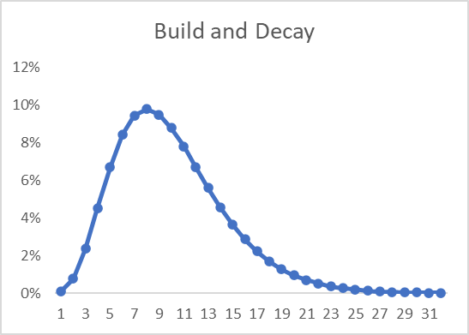
Variable Transformation – Ad-stock with Gamma
Why?
It assumes that viewers who are exposed to media activity make purchases after some time and then declines exponentially within a specific period
There are three parameters to consider:
Degrees of Freedom: The minimum time (# of days) required for the advertisement to run and impact the viewers to make purchase decision
Number of days: # days for the impact to reach maximum
Decay: The amount of current period activity that effects the current period.
This type of transformation is frequently used with digital media (Social media, Search Ad, etc.,) where exposure takes time to build in the minds of consumers before their purchase decision

Slide 5
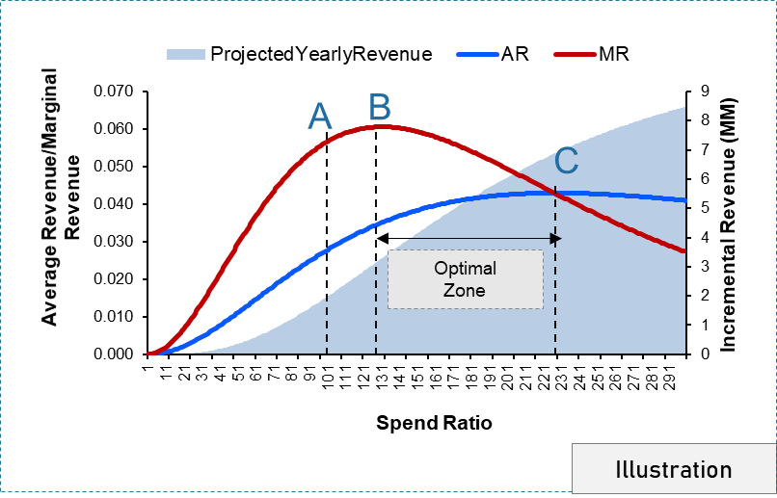
Response Curves
Response curve is a mechanism identifying how your Response (Incr. Revenue Per Impression) moves along with additional spend. It helps you explain what the optimal level of spend is to attain the maximum volume response and what is your saturation point.
Point A: Current Threshold- This is the amount of spend that is currently used by the media tactics.
Point B: Maximum Marginal - At this point, the maximum volume response per one Impression is reached. Marginal Digital media response is maximized i.e. the rate of increase after this point will not be the same as you increase the amount of spend
Point C: Maximum ROI- At this point, the best returns are obtained for the level of investment.
Optimal Range :
Between point B and C- After point B, marginal Digital media response per spend declines; however, cumulative volume per cumulative spend (Digital media
responsiveness) are still rising which causes ROI to rise. After point C, Digital media response and ROI diminish.

Slide 6
Thank you

